Slide 1
JEOPARDY
Level: Advanced
Designed and created by Kids ESL Games

Slide 2
CATEGORIES
SUPERLATIVES
1 2 3 4 5
NAME FIVE
1 2 3 4 5
CHINA
1 2 3 4 5
ENTERTAINMENT
1 2 3 4 5
GEOGRAPHY
1 2 3 4 5
JOBS
1 2 3 4 5
SHAPES
1 2 3 4 5
WEATHER
1 2 3 4 5
BUILDINGS
1 2 3 4 5
TRANSPORT
1 2 3 4 5

Slide 3
SUPERLATIVES 100
What is the longest river in the world?
The Nile
BACK

Slide 4
SUPERLATIVES 200
What is the fastest animal in the world?
Cheetah
BACK

Slide 5
SUPERLATIVES 300
What is the longest man-made structure in the world?
The Great Wall of China
BACK

Slide 6
SUPERLATIVES 400
What is the highest mountain in the world?
Mount Everest
BACK

Slide 7
SUPERLATIVES 500
What’s the world’s slowest mammal?
The three–toed sloth
BACK

Slide 8
NAME FIVE 100
Name five South American countries?
Argentina, Brazil, Columbia, Peru, Chile...
BACK

Slide 9
NAME FIVE 200
Name five mammals.
Sheep, pigs, elephants, sloths, wolves...
BACK

Slide 10
NAME FIVE 300
Name five capital cities in Europe?
London, Rome, Athens, Paris, Oslo...
BACK

Slide 11
NAME FIVE 400
Name five countries that have won the football World Cup?
England, France, Italy, Brazil, Germany
BACK

Slide 12
NAME FIVE 500
Name five African countries?
Cameroon, Algeria, Kenya, Sudan, Ghana...
BACK

Slide 13
CHINA 100
What is the capital city of China?
Beijing
BACK

Slide 14
CHINA 200
What’s this called?
It’s a pagoda.
BACK

Slide 15
CHINA 300
What’s this called?
It’s a Wok.
BACK

Slide 16
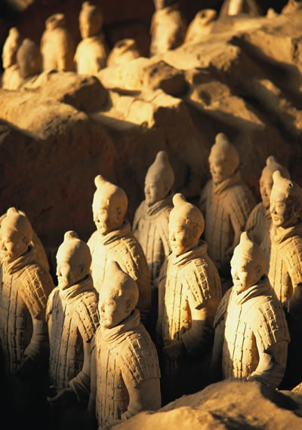
CHINA 400
What’s are these figures called?
Terracotta Warriors
BACK

Slide 17
CHINA 500
What’s the name of the city which borders with Hong Kong?
Shenzhen
BACK

Slide 18
ENTERTAINMENT 100
Who directed Jurassic Park?
Steven Spielberg
BACK

Slide 19
ENTERTAINMENT 200
Which male actor had the leading role in the film titanic?
Leonardo Di Caprio
BACK

Slide 20
ENTERTAINMENT 300
What’s this called?
It’s a film projector.
BACK

Slide 21
ENTERTAINMENT 400
What’s this called?
It’s a microphone.
BACK

Slide 22
ENTERTAINMENT 500
What’s this called?
It’s a tripod.
BACK

Slide 23
GEOGRAPHY 100
What’s the capital city of Peru?
The capital city is Lima.
BACK

Slide 24
GEOGRAPHY 200
What’s the capital city of Romania?
The capital city is Bucharest.
BACK

Slide 25
GEOGRAPHY 300
What’s this called?
It’s a volcano.
BACK

Slide 26
GEOGRAPHY 400
What’s this called?
It’s a tornado.
BACK

Slide 27
GEOGRAPHY 500
What area of Europe is this?
It’s Scandinavia.
BACK

Slide 28
JOBS 100
Who works in a bakery?
A baker works in a bakery.
BACK

Slide 29
JOBS 200
Who fixes vehicles?
A mechanic fixes vehicles.
BACK

Slide 30
JOBS 300
What’s my job?
I’m a photographer.
BACK

Slide 31
JOBS 400
What’s my job?
I’m a roofer.
BACK

Slide 32
JOBS 500
What’s my job?
I’m a seamstress.
BACK

Slide 33
SHAPES 100
What shape is this?
It’s a cross.
BACK

Slide 34
SHAPES 200
What shape is this?
It’s a diamond.
BACK

Slide 35
SHAPES 300
What shape is this?
It’s a hexagon.
BACK

Slide 36
SHAPES 400
What shape is this?
It’s an octagon.
BACK

Slide 37
SHAPES 500
What shape is this?
It’s a parallelogram.
BACK

Slide 38
WEATHER 100
What’s the weather like?
Lightning
BACK

Slide 39
WEATHER 200
What’s this called?
It’s called a thermometer.
BACK

Slide 40
WEATHER 300
What can an underwater earthquake cause?
Tsunami
BACK

Slide 41
WEATHER 400
What is ejected from a volcano when it erupts ?
Ash, molten rock, ashes...
BACK

Slide 42
WEATHER 500
What is an avalanche?
An avalanche is a rapid flow of snow down a slope.
BACK

Slide 43
BUILDINGS 100
What’s the name of this building?
Arc de Triumphe
BACK

Slide 44
BUILDINGS 200
What’s the name of this building?
Colosseum
BACK

Slide 45
BUILDINGS 300
What’s the name of this structure?
Stonehenge
BACK

Slide 46
BUILDINGS 400
What’s the highest man-made structure in Asia?
The Burj Khalifa in Dubai is the highest man-made structure.
BACK

Slide 47
BUILDINGS 500
What is the largest public square in the world?
Tiananmen Square
BACK

Slide 48
TRANSPORT 100
What’s this?
It’s a helicopter.
BACK

Slide 49
TRANSPORT 200
What’s this?
It’s a hot air balloon.
BACK

Slide 50
TRANSPORT 300
What’s this?
It’s a blimp.
BACK

Slide 51
TRANSPORT 400
A vehicle that hovers over land and water
Hovercraft
BACK

Slide 52
TRANSPORT 500
What’s the name of this boat?
It’s a gondola.
BACK

Slide 53
Thanks for using PowerPoint at www.kidseslgames.com
BACK

